Slide 1
Elasticity
Purpose : Physical introduction to elasticity,
- Stress
Strain
Relationship
Methods of resolution
Elasticity - CAUC - Tian Jin - 2011

Slide 2
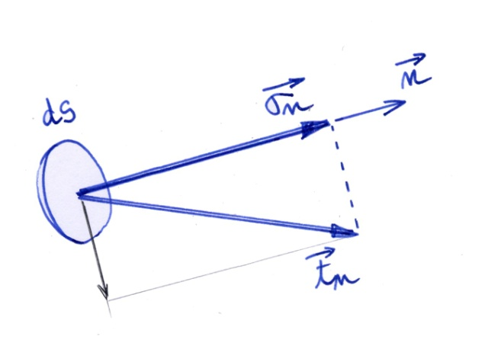
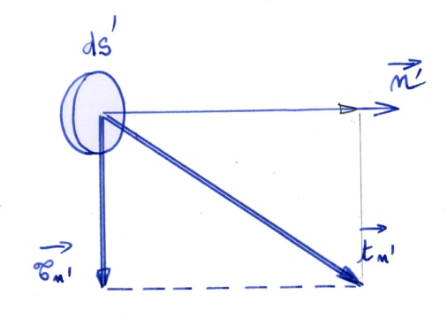
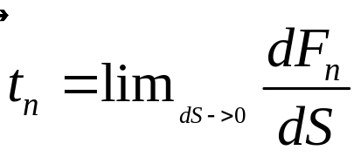
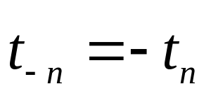
Stress vector
Remark :
Elasticity - CAUC - Tian Jin - 2011

Slide 3
Stress Tensor
Conclusion 1 : In a point M of a structure, we can define
as many stress vectors that there are normal
vector issued of the point M
Conclusion 2 : We need a tool to represent the state of
Stresses in a single point of a solid body
Elasticity - CAUC - Tian Jin - 2011

Slide 4
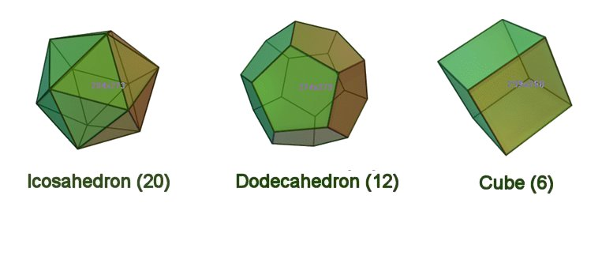
Equilibrium
Question : How many independent stress vectors
are in a point ?
Tool for answer : Equilibrium of a very small volume.
Elasticity - CAUC - Tian Jin - 2011

Slide 5
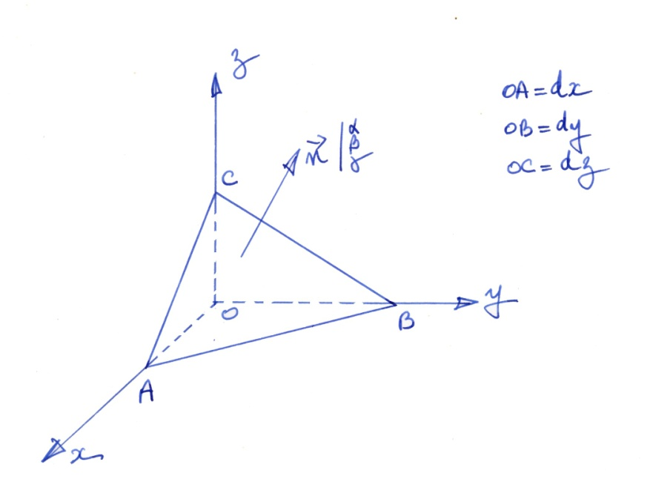
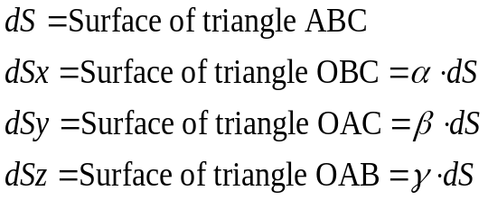
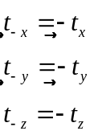
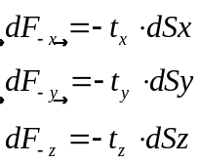

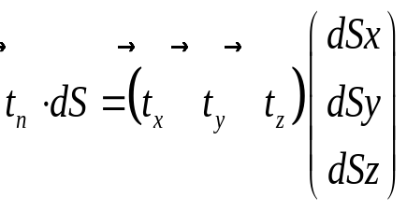
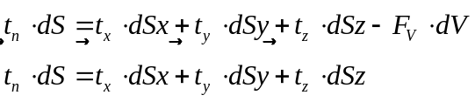
Equilibrium of a tetrahedron
Elasticity - CAUC - Tian Jin - 2011

Slide 6
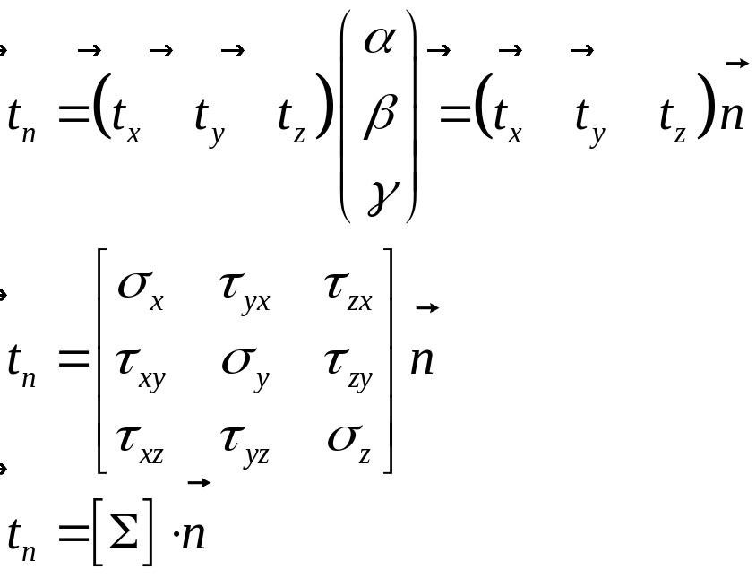
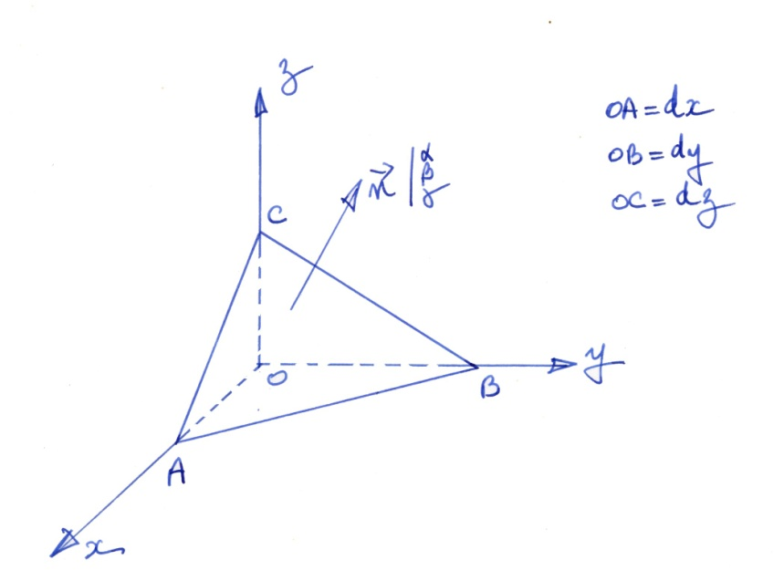
Equilibrium of a tetrahedron
Elasticity - CAUC - Tian Jin - 2011

Slide 7
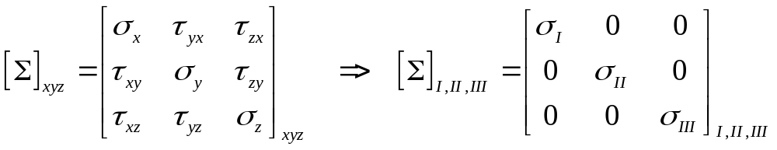
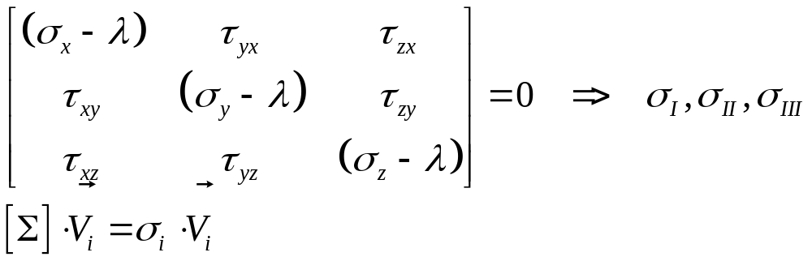
Representation of a tensor by a Mohr’s Circle
There is an axis system such as the tensor is a diagonal tensor
Elasticity - CAUC - Tian Jin - 2011

Slide 8
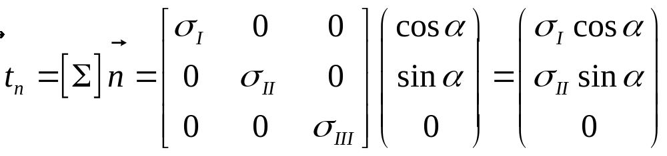
Mohr’s Circle
We shall study the stresses when the output normal to a little surface is inside the principal plane for stresses (I, II)
Conclusion : When the output normal is inside a principal plane for stresses, then, the stress vector is inside the same plane
Elasticity - CAUC - Tian Jin - 2011

Slide 9
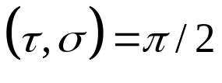
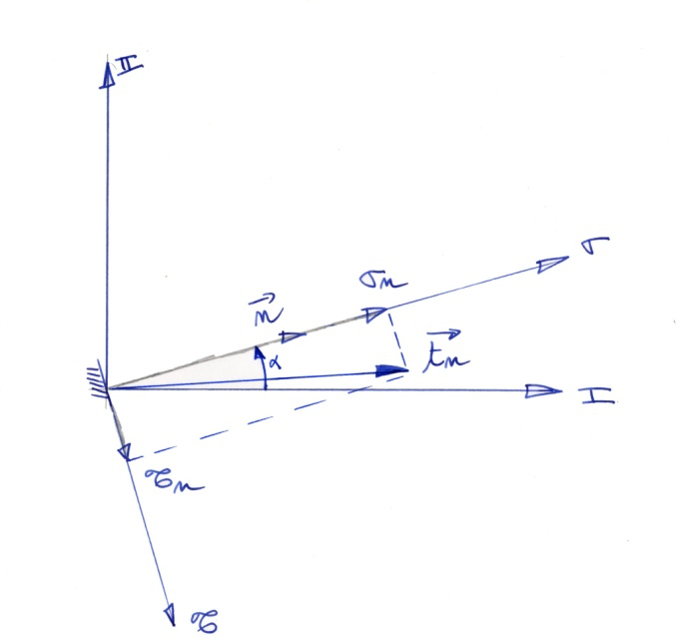
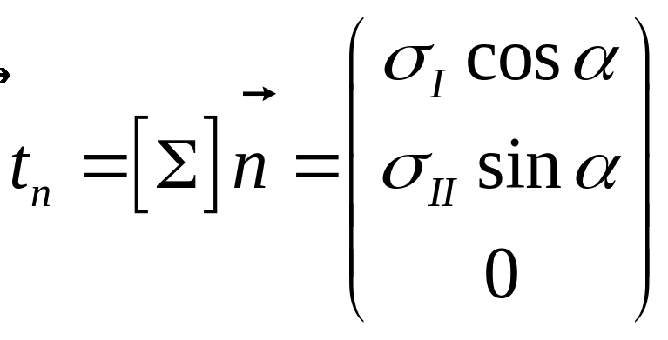
Mohr’s Circle
Remark : In a principal plane for stresses, we define the
Mohr’s axis such as :
Elasticity - CAUC - Tian Jin - 2011

Slide 10
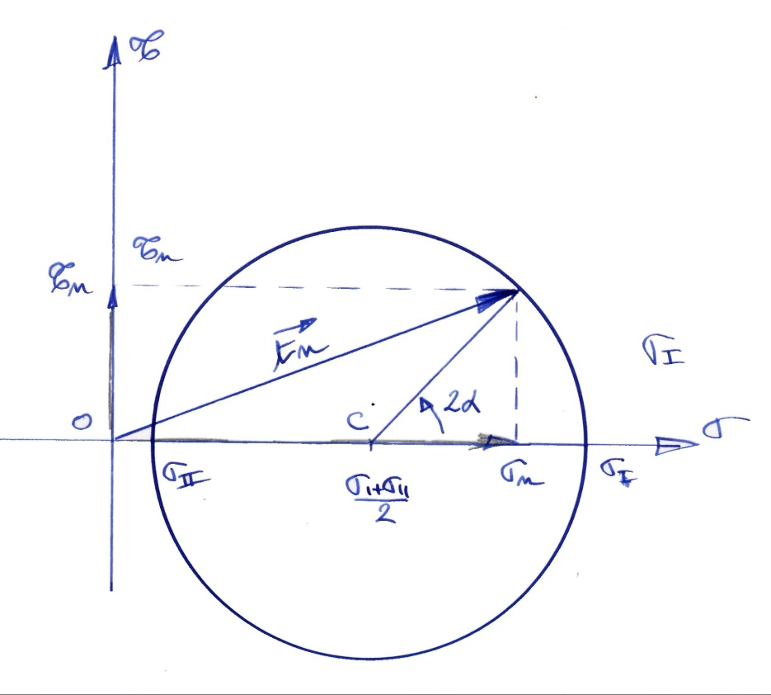
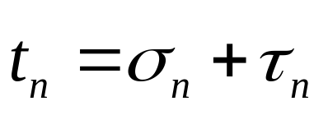
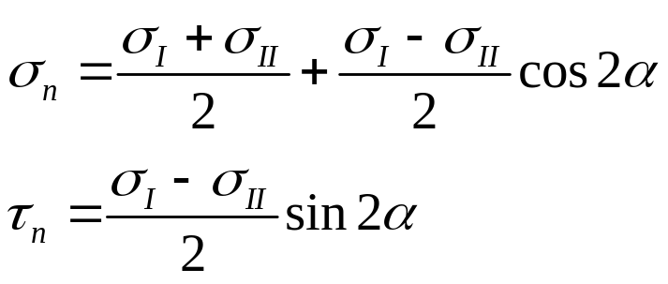
Mohr’s Circle
Elasticity - CAUC - Tian Jin - 2011

Slide 11
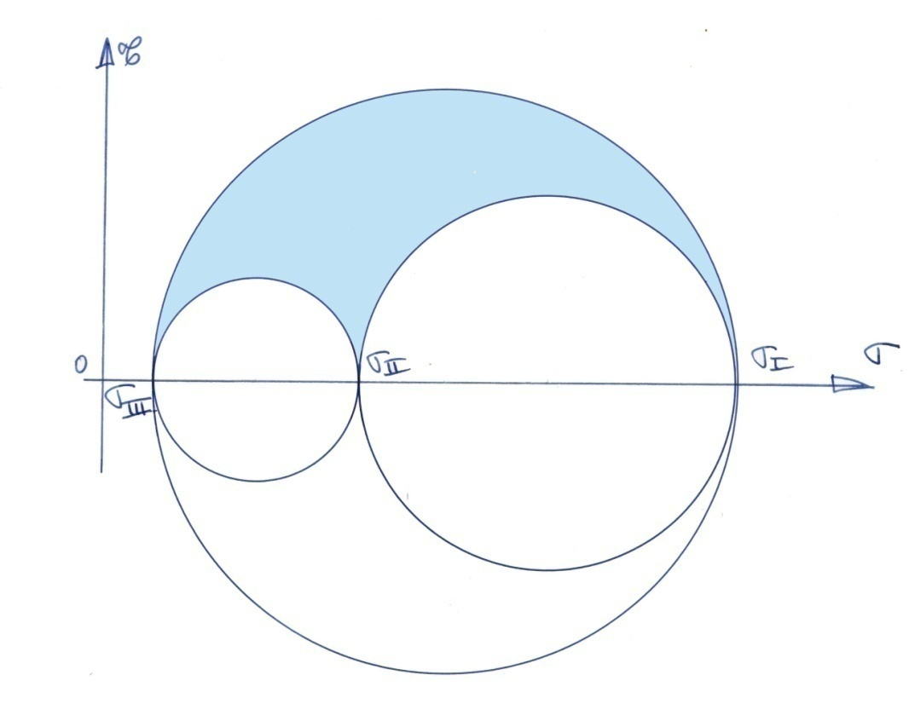
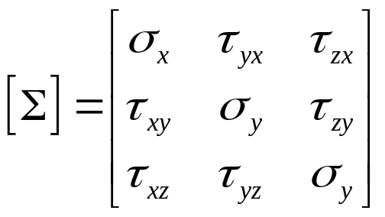
Full Mohr’s Circle
Elasticity - CAUC - Tian Jin - 2011

Slide 12
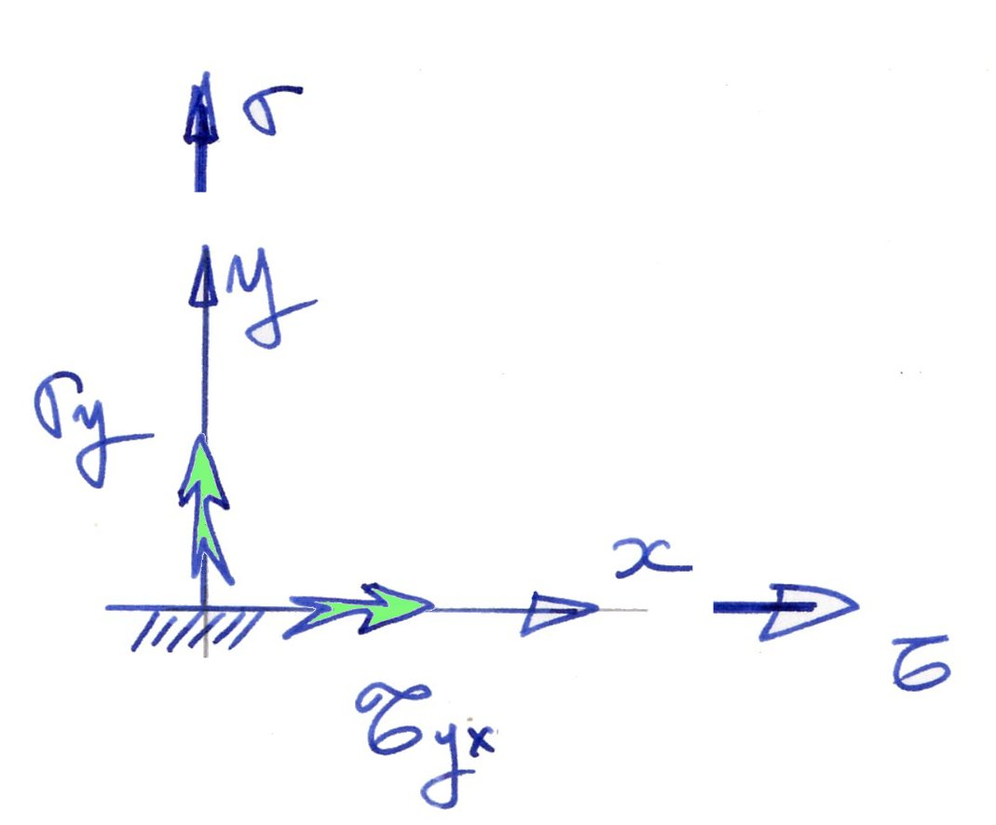
Mohr’s Circle
Remark 1 : On a small surface whose output normal is y the shear stress is represented on the Mohr’s circle by a positive value
Elasticity - CAUC - Tian Jin - 2011

Slide 13
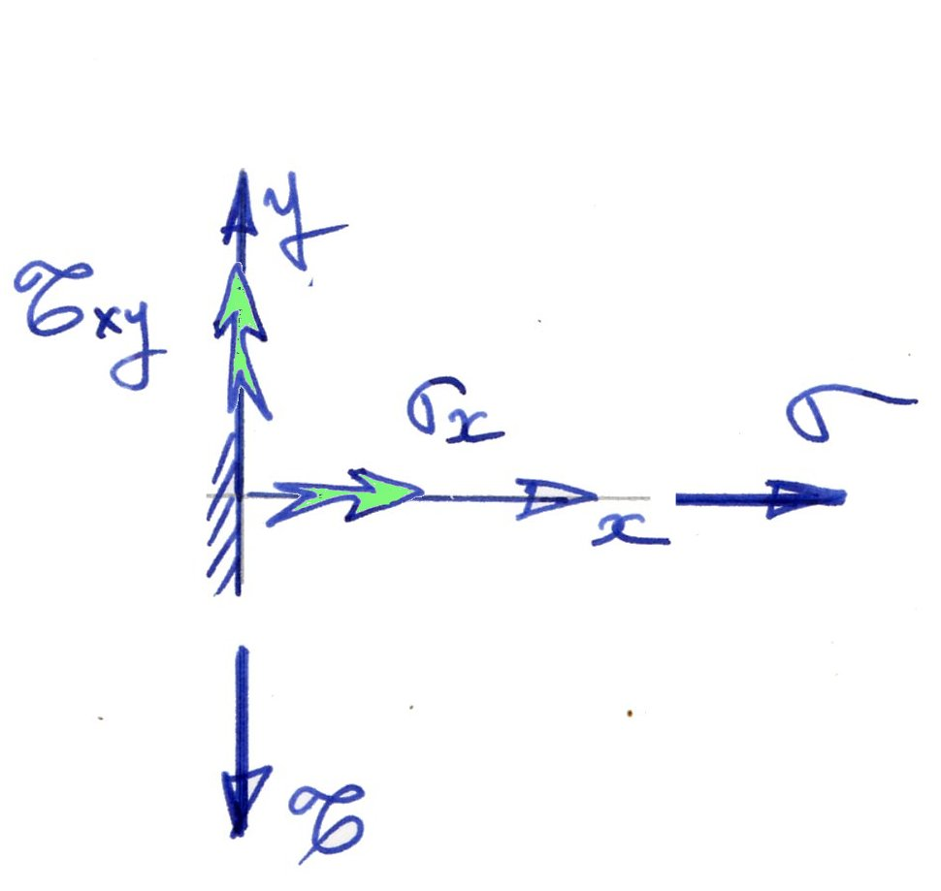
Mohr’s Circle
Remark 2 : On a small surface whose output normal is x the shear stress is represented on the Mohr’s circle by a negative value
Elasticity - CAUC - Tian Jin - 2011

Slide 14
Remark
How many unknown quantity in the stress tensor ?
How many equations ?
Equilibrium of the forces,
Equilibrium of the moments.
Elasticity - CAUC - Tian Jin - 2011

Slide 15
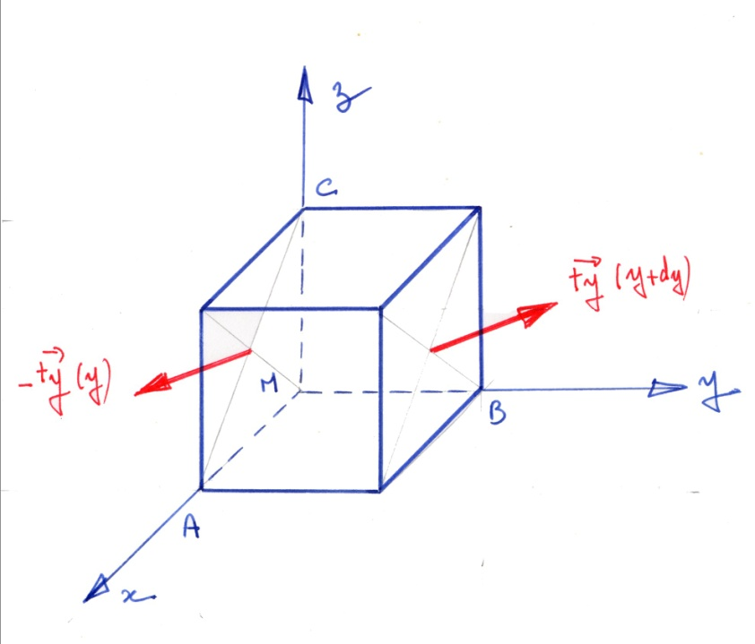
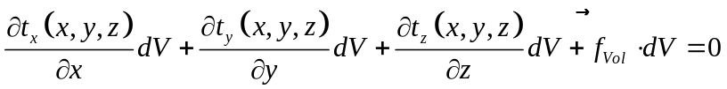
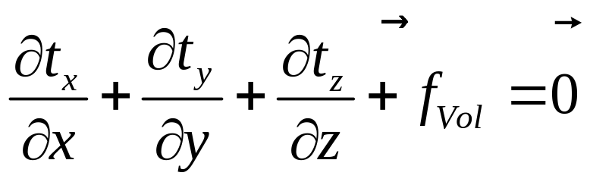
Equilibrium of the forces
Elasticity - CAUC - Tian Jin - 2011

Slide 16
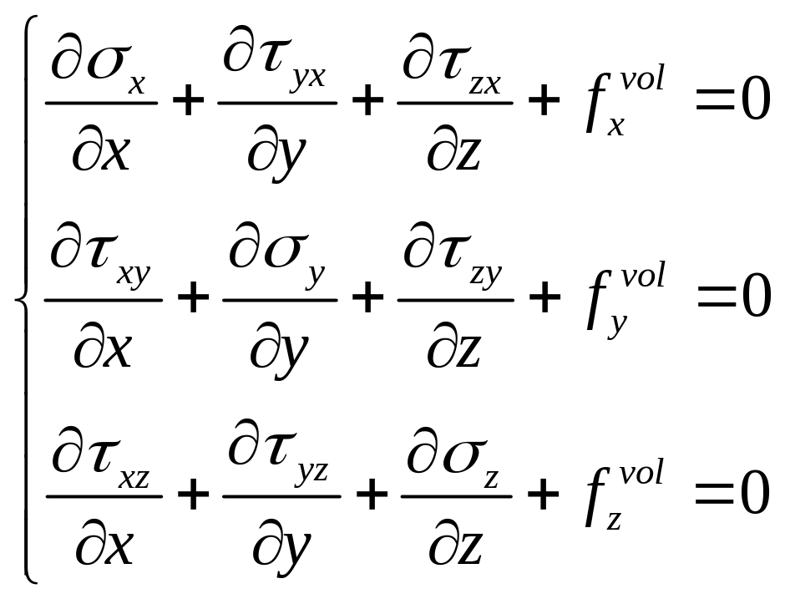
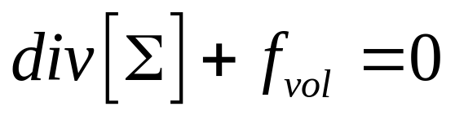
Equilibrium Equations
Elasticity - CAUC - Tian Jin - 2011

Slide 17
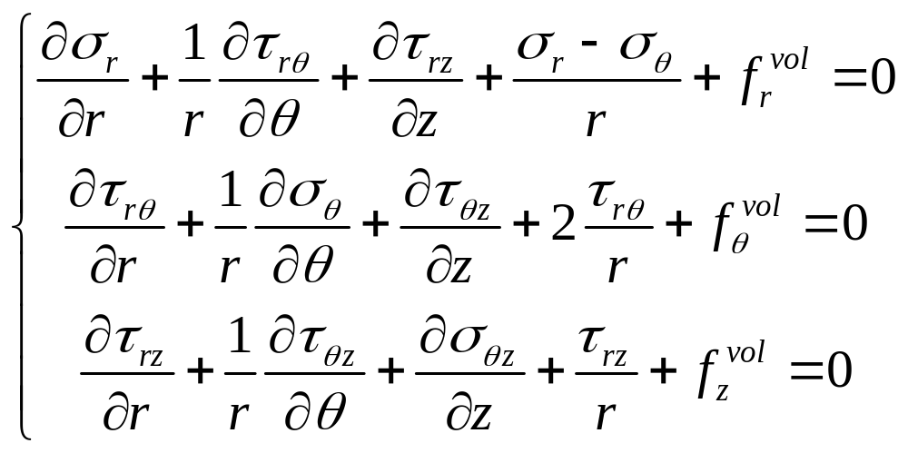
Equilibrium Equations
Elasticity - CAUC - Tian Jin - 2011

Slide 18
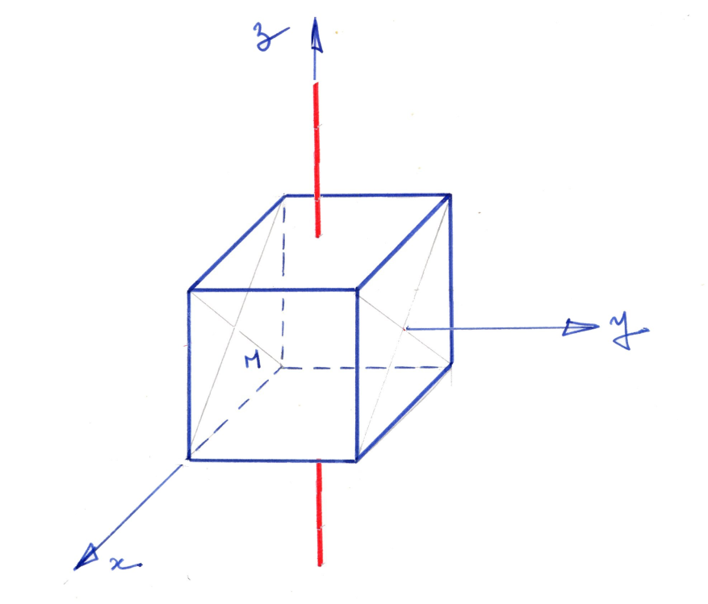
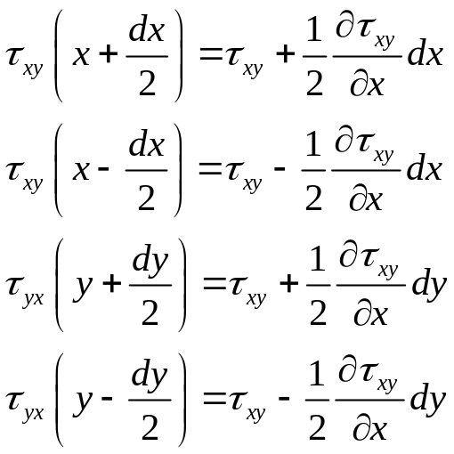
Equilibrium of the moments
By writing the equilibrium of the moments, we can demonstrate that the tensor of stress is a symmetric tensor.
Elasticity - CAUC - Tian Jin - 2011

Slide 19
Remark
How many unknown quantity in the stress tensor ? 9
How many equations ?
Equilibrium of the forces, 3
Equilibrium of the moments. 3
Conclusion : There is an infinity of solutions
Elasticity - CAUC - Tian Jin - 2011

Slide 20
Remark
Stresses are very important to find for the engineer. Because the knowledge of the stresses allows the engineer to design structures that will never breakdown.
Elasticity - CAUC - Tian Jin - 2011

Slide 21
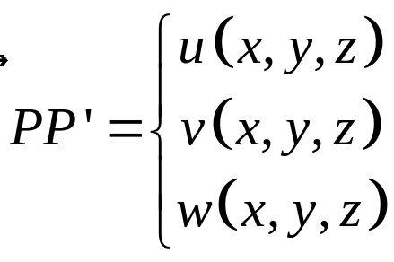
Displacement
Displacements are very important to find for the engineer. Because the knowledge of the displacement allows the engineer to design the structures with the good stiffness.
Each point P of the structure will have a displacement
when the load will be applied. This displacement is a vector with 3 unknown components.
Therefore, we need now 6 equations !!!
Elasticity - CAUC - Tian Jin - 2011

Slide 22
Strains
The strains are very usefull because :
There is a linear relation between stresses and strains
By integration of the strains it’s possible to find the displacements.
Equations of compatiblity are very easy to demonstrate in term of strain
Strain allows us to find the 6 equations we need to solve a problem of structure
Elasticity - CAUC - Tian Jin - 2011

Slide 23
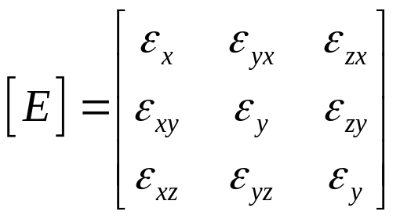
Strains
We can define a strain tensor with 6 components like this :
Elasticity - CAUC - Tian Jin - 2011

Slide 24
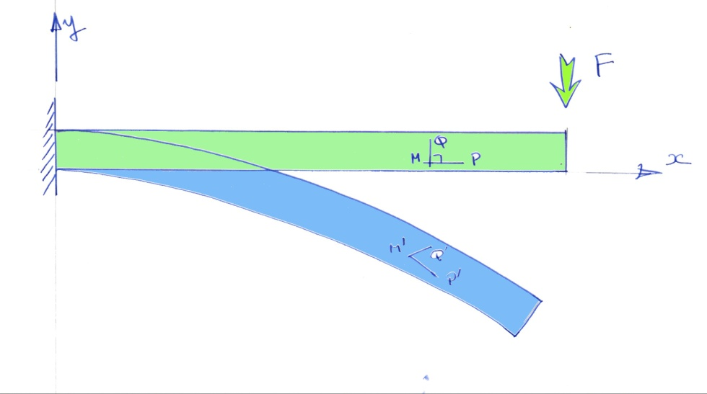
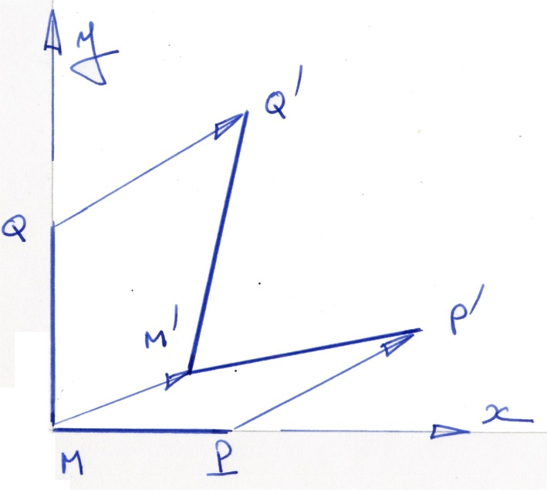
Strains
Elasticity - CAUC - Tian Jin - 2011

Slide 25
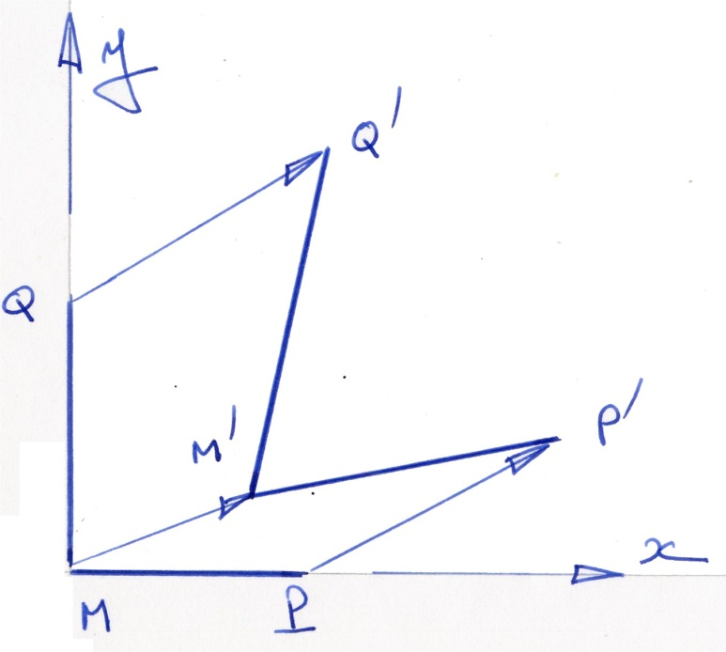
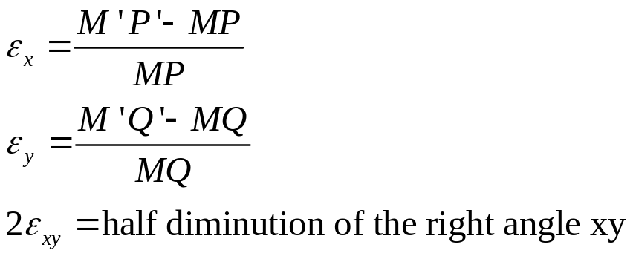
Strains : Definition
Elasticity - CAUC - Tian Jin - 2011

Slide 26
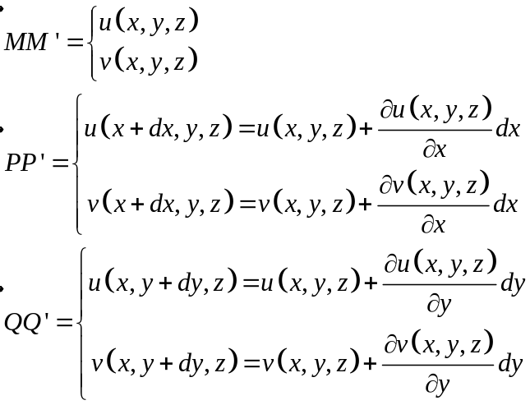
Strains
Elasticity - CAUC - Tian Jin - 2011

Slide 27
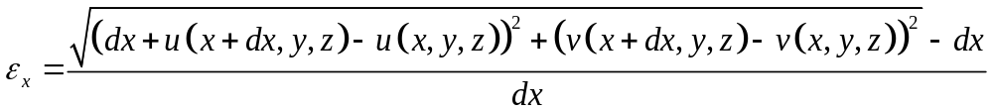
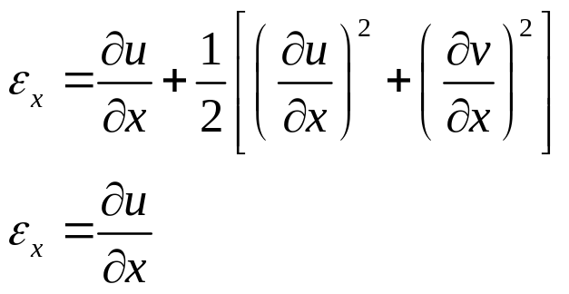
Strains
Elasticity - CAUC - Tian Jin - 2011

Slide 28
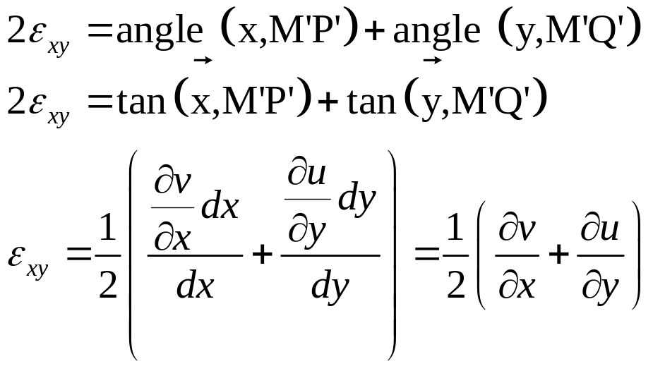
Strains
Elasticity - CAUC - Tian Jin - 2011

Slide 29
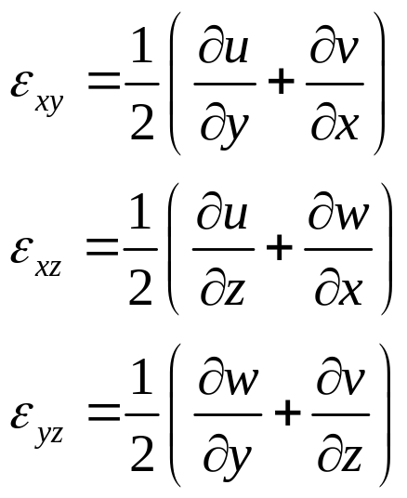
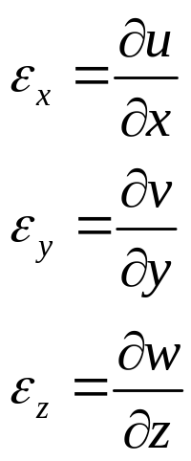
Relation between strain and displacement
Elasticity - CAUC - Tian Jin - 2011

Slide 30
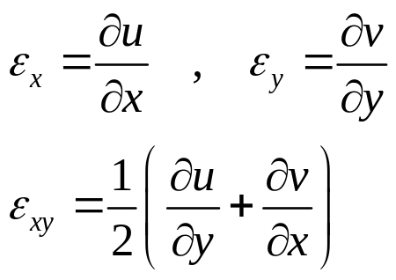
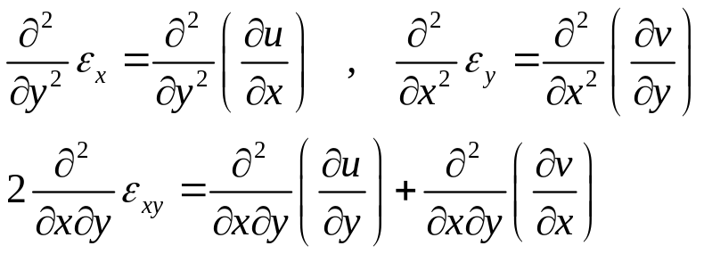
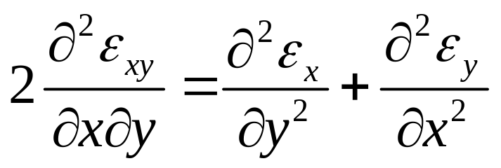
Compatibility Equations
Elasticity - CAUC - Tian Jin - 2011

Slide 31
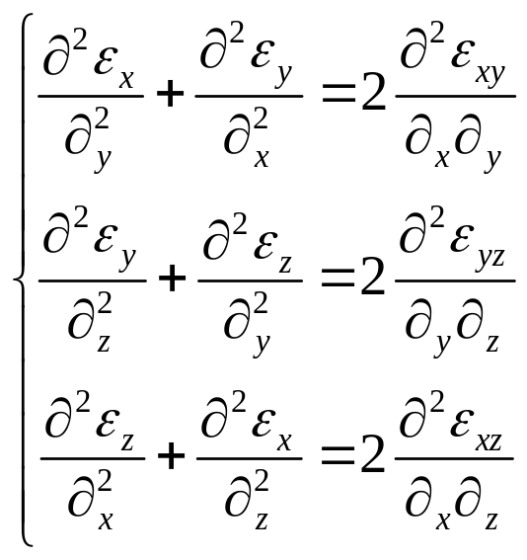

Equation for Compatibility
Elasticity - CAUC - Tian Jin - 2011

Slide 32


Rotation
Elasticity - CAUC - Tian Jin - 2011

Slide 33



Mohr Circle for the Strains
Elasticity - CAUC - Tian Jin - 2011

Slide 34



Memorize what we will need !
Elasticity - CAUC - Tian Jin - 2011

Slide 35




Memorize what we will need !
Elasticity - CAUC - Tian Jin - 2011

Slide 36




Memorize what we will not need !
Elasticity - CAUC - Tian Jin - 2011

Slide 37
Relationship Stress / Strain
This relation ship is due to :
Robert Hooke
Denis Poisson
Thomas Young
Gabriel Lamé
Elasticity - CAUC - Tian Jin - 2011

Slide 38

Robert Hooke
Robert Hooke, né le 18 juillet 1635 à Freshwater (Île de Wight) et mort le 3 mars 1703 à Londres, est un des plus grands scientifiques expérimentaux du XVII^{e siècle} et donc une des figures clés de la révolution scientifique de l'époque moderne.
Elasticity - CAUC - Tian Jin - 2011

Slide 39

Denis Poisson
Siméon Denis Poisson
(21 juin 1781 à Pithiviers - 25 avril 1840 à Sceaux) est un mathématicien, géomètre et physicien français.
Elasticity - CAUC - Tian Jin - 2011

Slide 40

Thomas Young
Thomas Young (13 juin 1773-10 mai 1829), est un physicien, médecin et égyptologue britannique.
Elasticity - CAUC - Tian Jin - 2011

Slide 41

Relationship Stress / Strain
Elasticity - CAUC - Tian Jin - 2011

Slide 42

Relationship Stress / Strain
Elasticity - CAUC - Tian Jin - 2011

Slide 43

Relationship Stress / Strain
Elasticity - CAUC - Tian Jin - 2011

Slide 44

Relationship Stress/ Strain
Elasticity - CAUC - Tian Jin - 2011

Slide 45


Relationship Stress/ Strain
Elasticity - CAUC - Tian Jin - 2011

Slide 46

Method of resolution
Eugenio Beltrami, , est un mathématicien et physicien italien né le 16 novembre 1835 à Crémone, mort le 18 février 1900 à Rome.
Elasticity - CAUC - Tian Jin - 2011

Slide 47

Method of resolution
Gabriel Lamé (22 juillet 1795, Tours - 1er mai 1870, Paris) est un mathématicien français
Elasticity - CAUC - Tian Jin - 2011

Slide 48

Methods of resolution
Benoît Paul Émile Clapeyron, né 26 février 1799 à Paris et mort le 28 janvier 1864 dans cette même ville, est un ingénieur et physicien français.
Elasticity - CAUC - Tian Jin - 2011

Slide 49


Internal Energy
The internal energy in a small volume dV is equal to :
Elasticity - CAUC - Tian Jin - 2011

Slide 50




Principe of the strain gauge
l
Elasticity - CAUC - Tian Jin - 2011

Slide 51



Principe of the strain gauge
x
r
l
y
z
Elasticity - CAUC - Tian Jin - 2011

Slide 52

Influence of the metal gauge
Elasticity - CAUC - Tian Jin - 2011

Slide 53

Influence of the metal gauge
Elasticity - CAUC - Tian Jin - 2011

Slide 54

Influence of the metal gauge
Elasticity - CAUC - Tian Jin - 2011

Slide 55

Influence of the metal gauge
Elasticity - CAUC - Tian Jin - 2011

Slide 56



Strain gauge : results
l
Elasticity - CAUC - Tian Jin - 2011

Slide 57




Wheatstone’s Bridge
C
R₁
R₄
A
v
B
R₃
R₂
D
E
Elasticity - CAUC - Tian Jin - 2011

Slide 58

Wheatstone’s Bridge
Quarter bridge
v
Application
Measurement of Strain
Equilibrium of the bridge
R₁=R₂=R₃=R₄=R
E
Elasticity - CAUC - Tian Jin - 2011

Slide 59

Wheatstone’s Bridge
r
Half Bridge
R
v
R
Insensitivity to temperature
r
E
Elasticity - CAUC - Tian Jin - 2011

Slide 60

Wheatstone’s Bridge
R
R
Full Bridge
v
Application :
EFFORT SENSOR
R
R
E
Elasticity - CAUC - Tian Jin - 2011

Slide 61


Correction thermique des jauges auto compensées
EA06 240 LZ 120
α₀= -3. 49
α₁ = 2. 92
α₂ = -6. 70E-2
α₃ = 3. 71E-4
α₄ =-4. 70E-7
Equation de la courbe : α₀+α₁Τ+α₂Τ²+α₃Τ³+α₄Τ⁴
Elasticity - CAUC - Tian Jin - 2011

Slide 62


Influence of connection wires
R
r
R
r
v
E
Elasticity - CAUC - Tian Jin - 2011

Slide 63


Temperature effects on the lead wires can be cancelled by using a "3-wire bridge"
r
R
R
r
r
v
E
Elasticity - CAUC - Tian Jin - 2011

Slide 64

Jauges simples
Elasticity - CAUC - Tian Jin - 2011

Slide 65

Rosettes de 2 jauges
Elasticity - CAUC - Tian Jin - 2011

Slide 66

Rosettes de 3 jauges
Elasticity - CAUC - Tian Jin - 2011

Slide 67

Rosettes superposées (2 ou 3 jauges)
Elasticity - CAUC - Tian Jin - 2011

